Slide 1

Robot Operating System for Making Hamburger Model with Deep Learning
Handong Global Univ.
School of Mechanical & Control Engineering
Dec.10.2024
Industrial AI & Automation
Middle Report of Project 2
Prof. Young-Keun Kim
21800226 Yunki Noh
21900258 Hyeonho Moon
21900727 Garam Jin

Slide 2
CONTENTS
1. Overall Tasks
2. Objective
3. Process
4. Demo
5. Usage Technique
6. Results & Discussion

Slide 3
1. Overall Tasks
Task | Name | Achievement
Hardware | Hyeonho | 1.Build up first type of gripper 2.Build up second type of gripper 3. Fix third type of gripper as a last type of gripper
 | Yunki | 1.Build up conveyor belt system with ultrasonic sensor 2. Build up fence system with stepper motor 3. Integrate conveyor and fence system with ultrasonic
 | Garam | 1. Decorate environment 2. Setting the Demo
Deep Learning | Garam | 1.Build up OCR detection system[Publish, Subscribe]
Image Processing | All | 1. Find contour for three types of patty
ROS_Indy10 | Yunki | 1.Build up serial communication between ros and Arduino[not used]
 | Hyeonho | 1.Modify image processing for extraction contour about three patties and (x, y) position of three paties
 | Garam | 1.Build up overall ROS simulation 2.Build up overall publish and subscribe system[Node, Publish, Subscribe, Topic] 3. Build up overall image processing parts

Slide 4
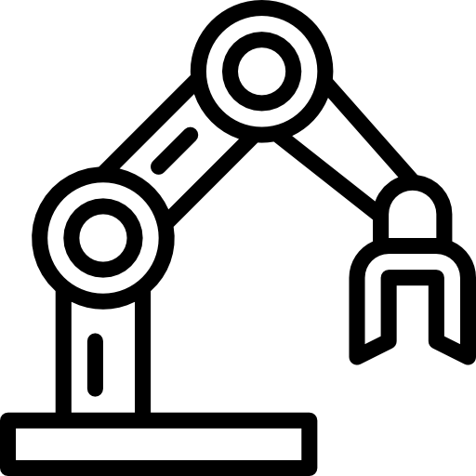
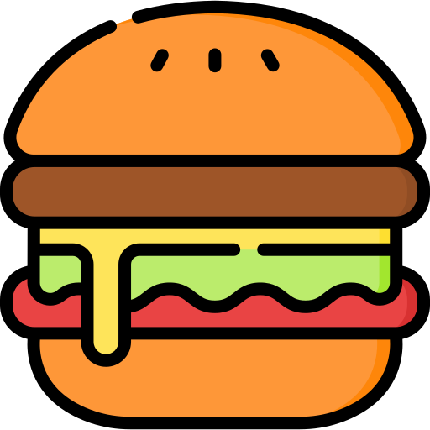

2. Objective
Subject:
Automate hamburger stacking system
by using ROS, Deep Learning, and Image Processing
Objective:
Classification the menu(Cheese, Bulgogi, Shrimp)
Automate hamburger stacking
Further Objective
Image Processing & Publish the Coordinate of PATTY
Focus on User-Friendly

Slide 5
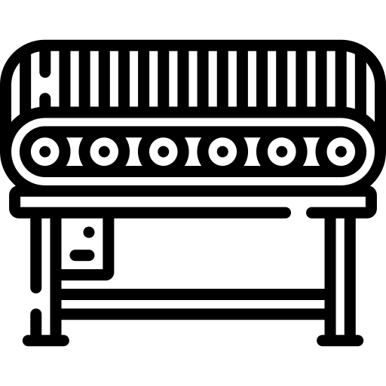



3. Process
Location 0: Standby
Location 1: Lettuce
Bread
Tomato
Location 2: Plate
Location 3: Patty
Location 4: Bell
Conveyor Belt
ROS
Patty
Order
Pick up
Standby → Bread → Plate → Lettuce → Plate → Patty → Plate → Tomato → Plate → Bread → Plate → Ring
Decision Factor: Gripper → Flipper , Calculate patty Specific Location, Publish & Subscribe Directions

Slide 6
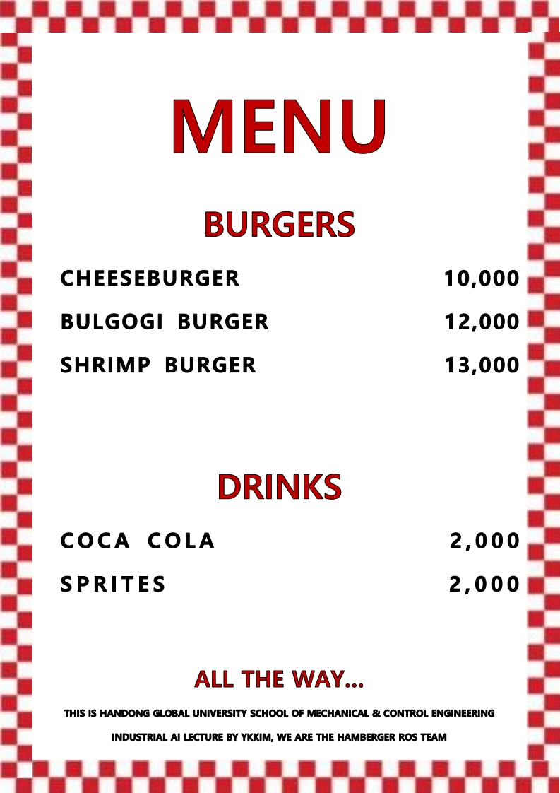
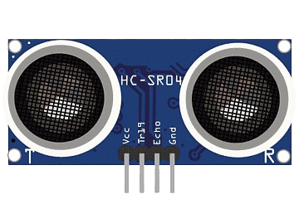
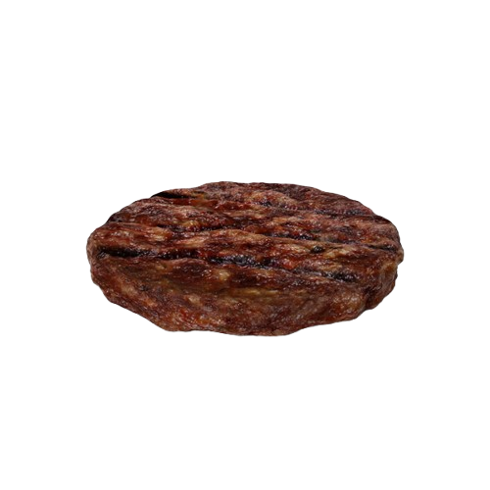
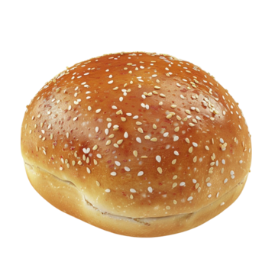
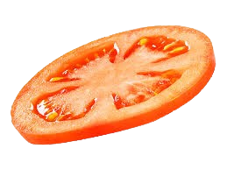
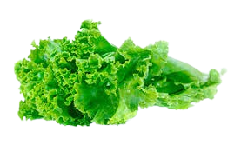
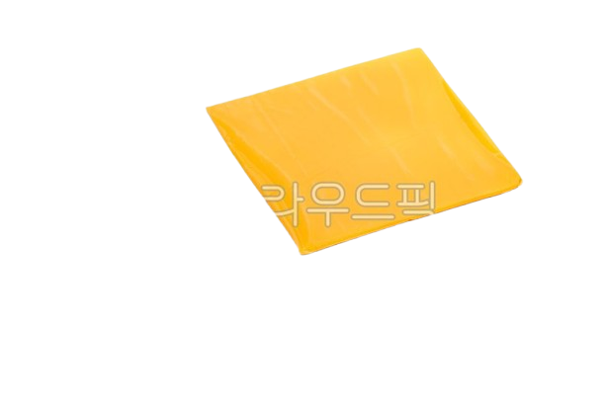
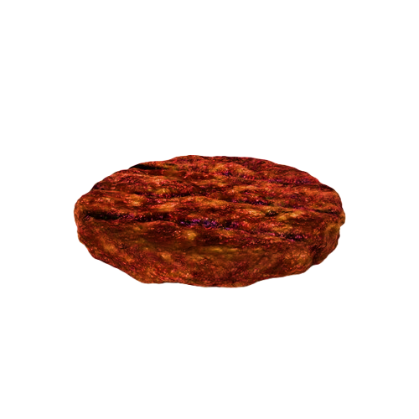

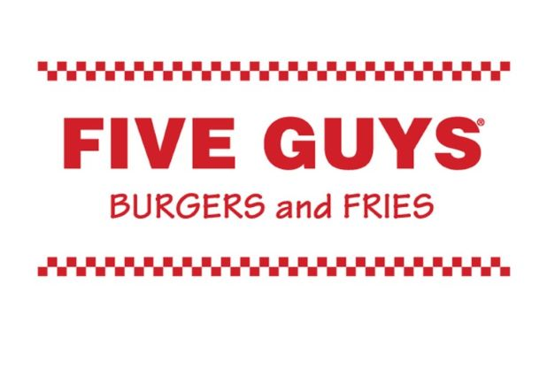



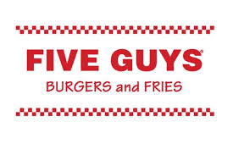
3. Process
3D Schematic
3
4
2
5
1
6
MENU
O R D E R
PICK UP
OCR Texts
Bulgogi Burger
Cheese Burger
Shrimp Burger

Slide 7
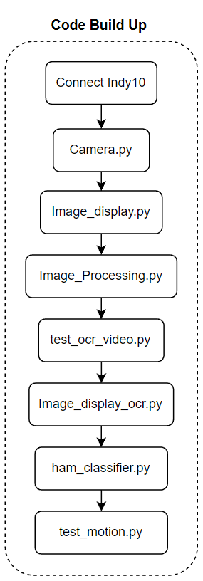
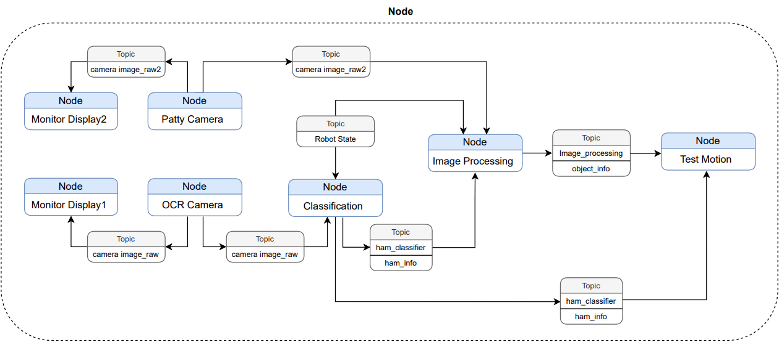
3. Process
7 Build up Process
7 Nodes & 8 Topics
Most Important Process: Image Process Node
Notes:
1. 켄버이어 벨트와 초음파 센서 결합
2. 초음파 센서 앞에 재료가 올 때마다 컨베이어 벨트 정지
3. ROS 로봇이 재료를 들고가면 다시 컨베이어 벨트 작동

Slide 8
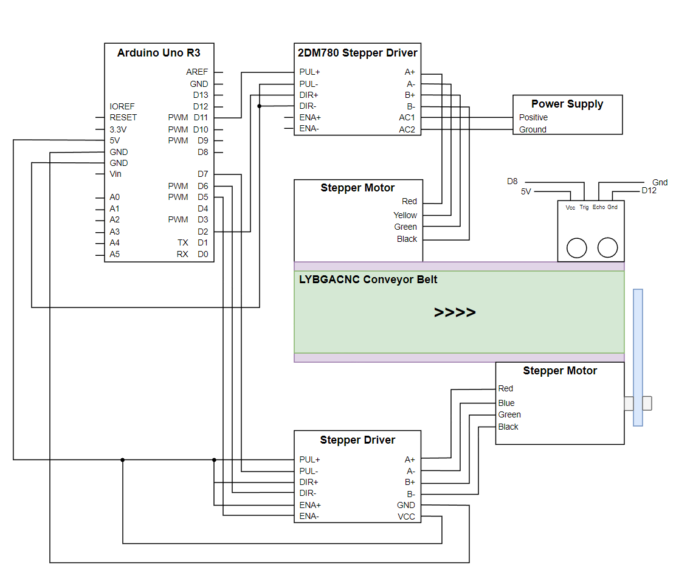
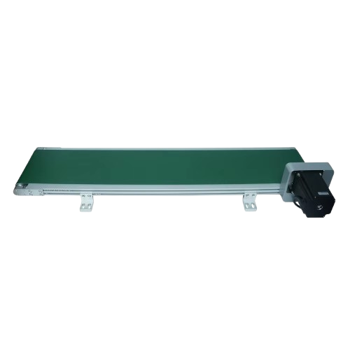
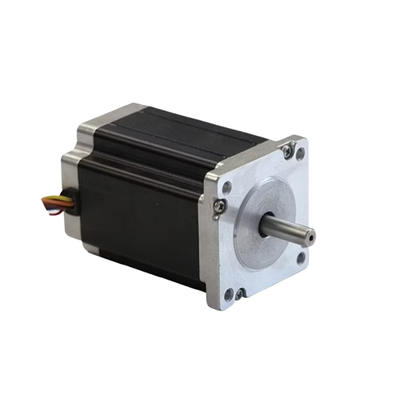



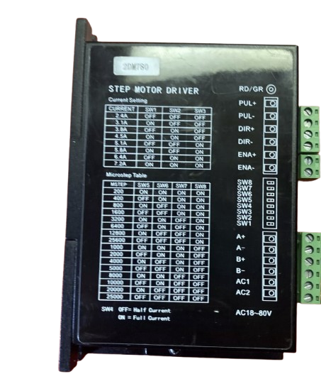
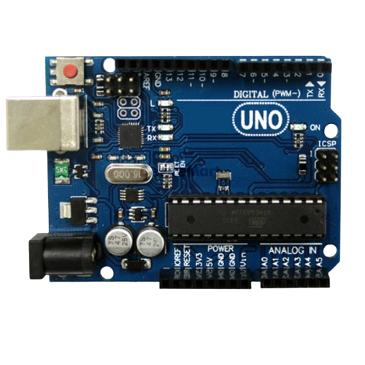
3. Process
Conveyor Belt
LYBGACNC Conveyor Belt
If distance < 20cm
Stop;
Close;
else if distance >= 20cm
Running;
Open;
Stepper Driver
Arduino Uno R3
Stepper Motor

Slide 9
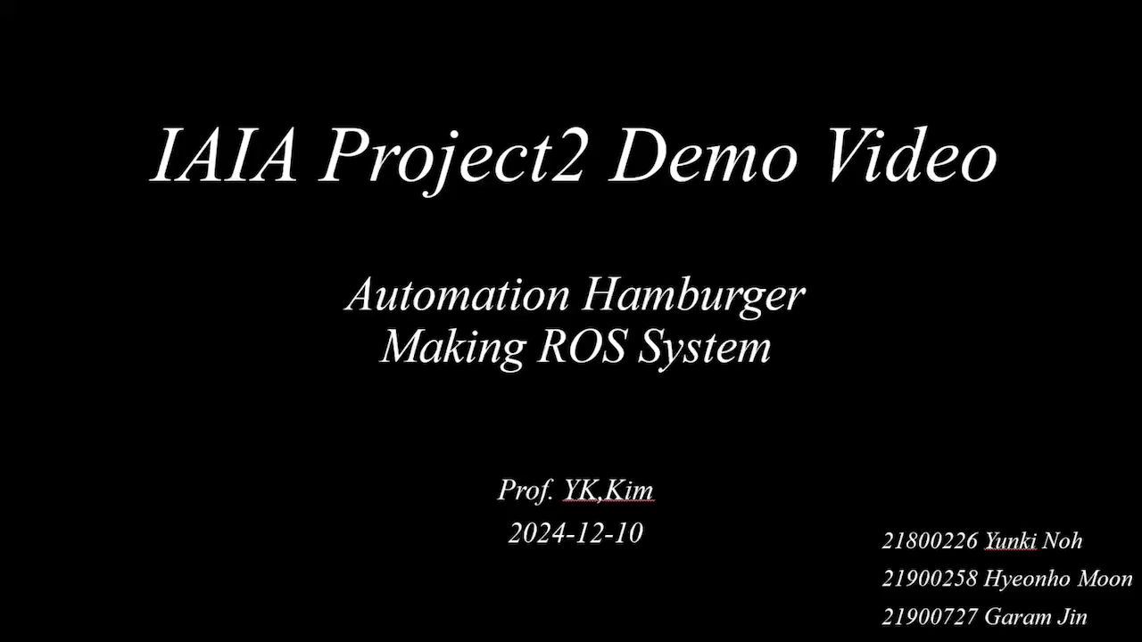
4. Demo
Notes:
재료가 일정하지 않아 그리퍼 적용이 불가
져로 길이에 상관없이 올릴수 있는 슬라이드 모델 채택
슬라이드 모드에 사용되는 모터 뚫음
기구 프린트 되면 적용 예정

Slide 10
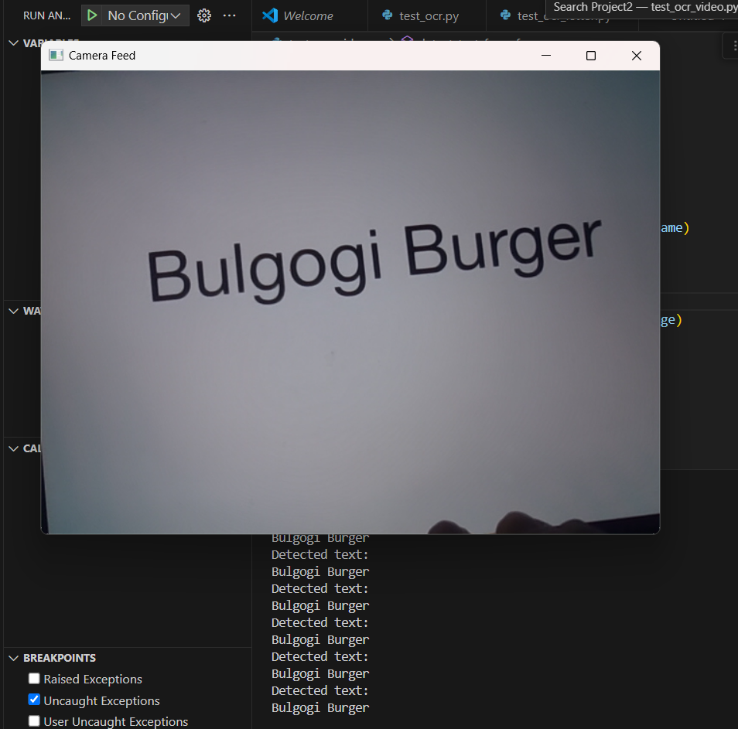
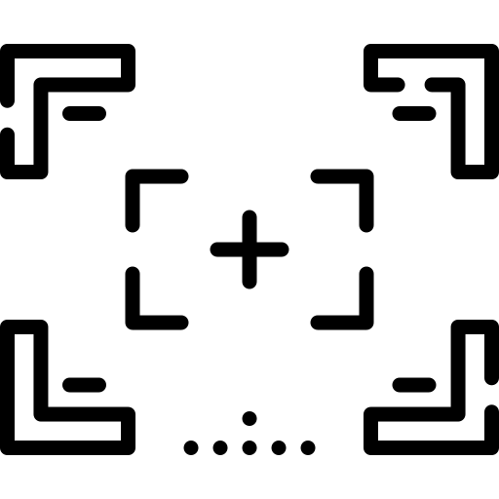
5. Usage Technique
Deep Learning:
OCR(Optical Character Recognition)
Detect 15 Times
Publish the information
Bulgogi Burger
Coca Cola
Need to grip the Materials & Can

Slide 11
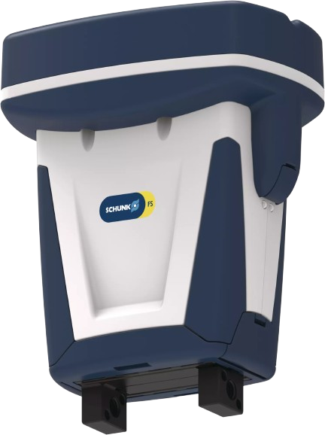
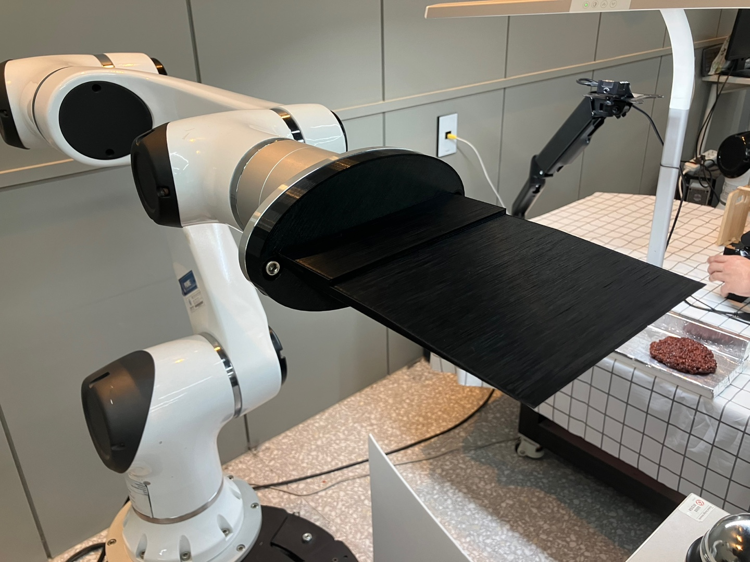
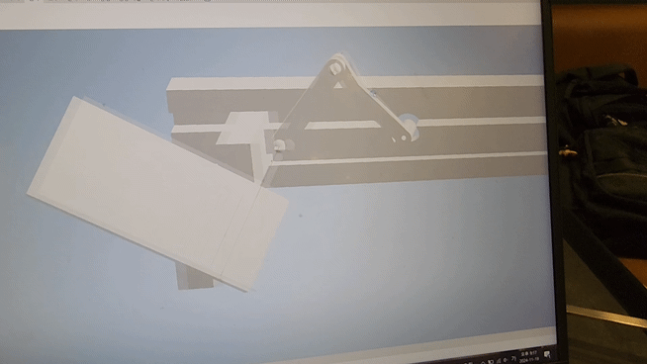
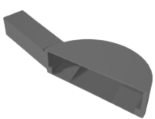
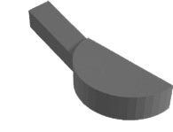
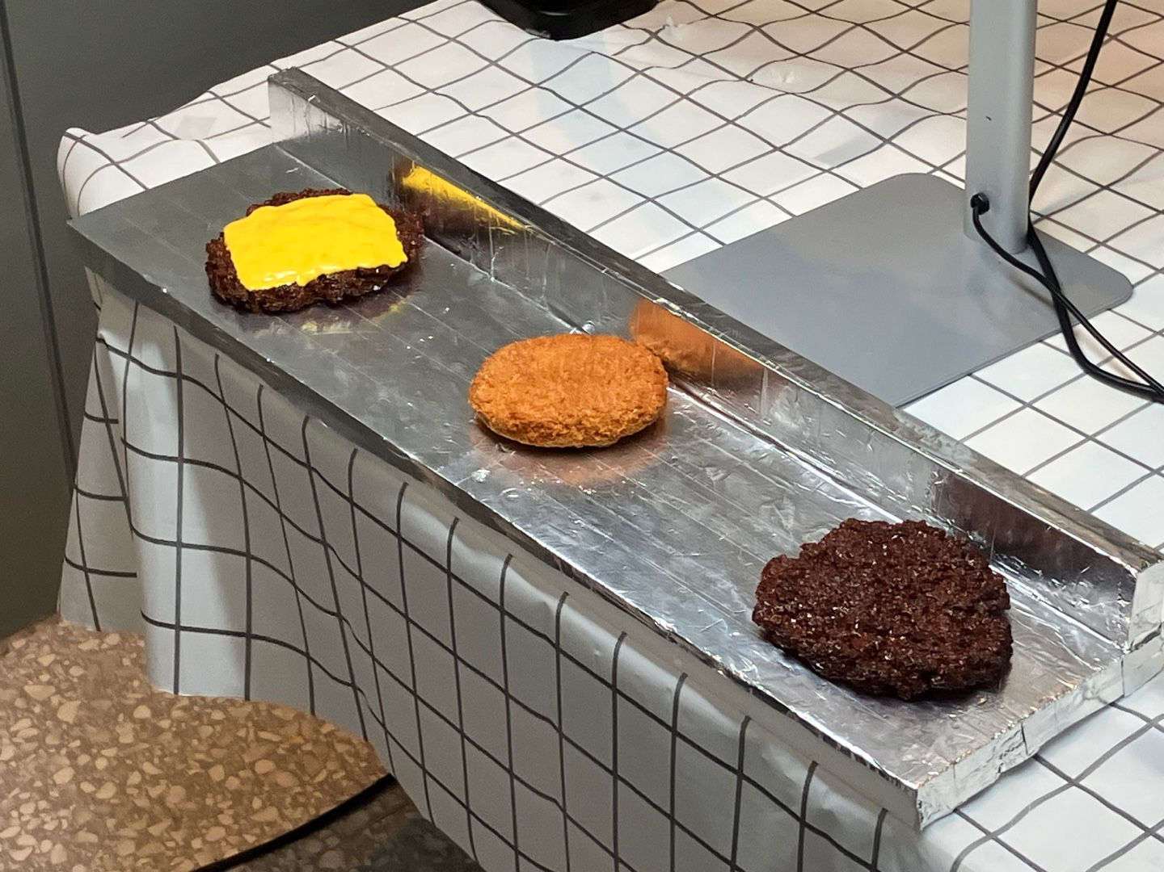
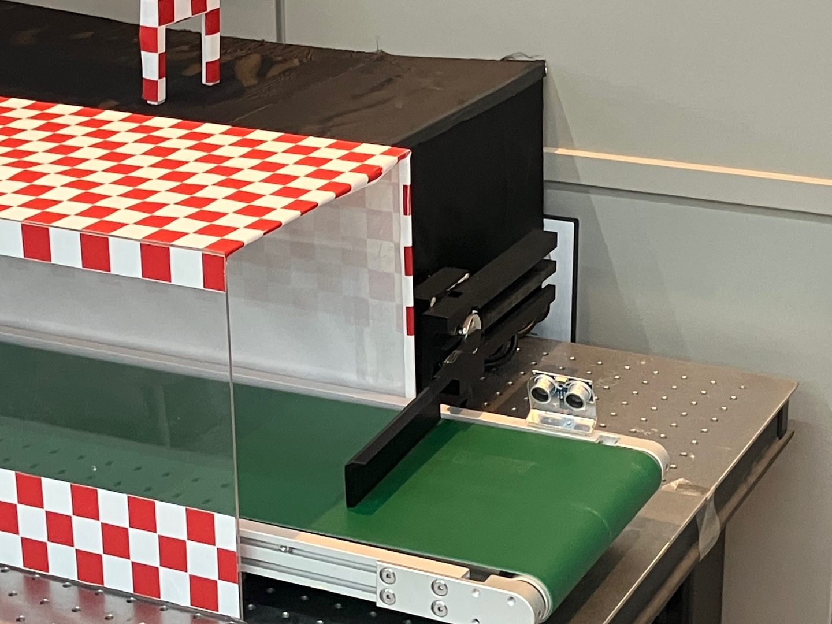
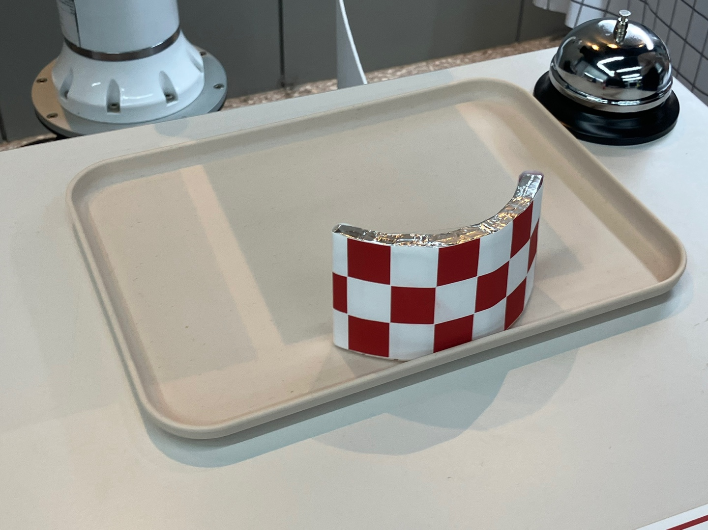
5. Usage Technique
Need to grip the Materials & Can
Notes:
그리퍼가 바뀌면서 각 파트 별로 밀리지 않게 장애물이 필요함.
따라서 각 파트별로 모터 및 장애물을 설치하였으며, 사용자가 불편하지 않게 설치하였다.

Slide 12
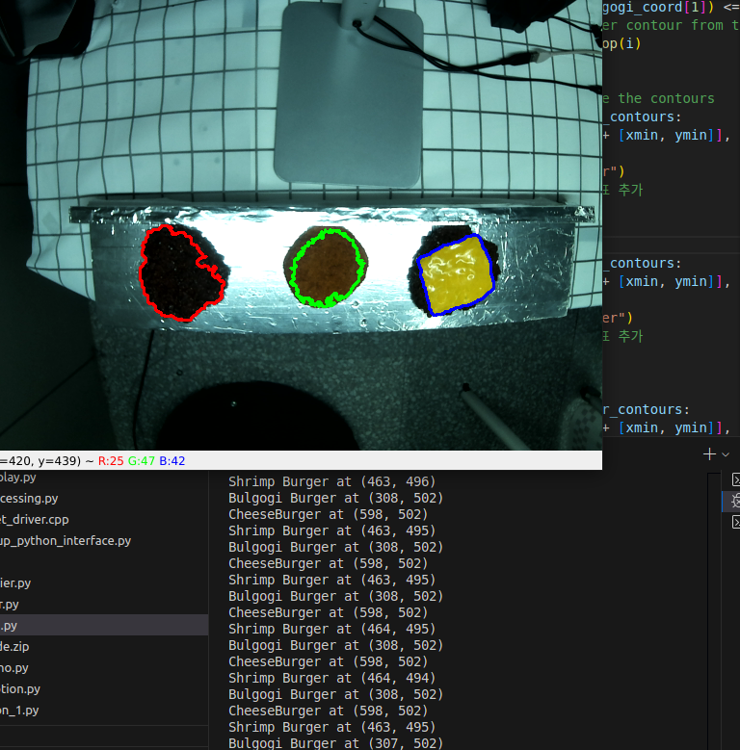
5. Usage Technique
Image Processing:
Classifying each patty using BGR.
Initially, grayscale was used, but there was significant light reflection from the patty grill.
Apply ROI
After Classifying each patty, the burger name and each center coordinates are published.
Add the stand light
Need to grip the Materials & Can
Notes:
BGR로 각각의 패티를 구분
처음에 그레이스케일로 했었다. 패티 그릴의 빛 반사가 심함.
ROI 추출
각 패티 별로 구분한 뒤, 햄버거의 이름과 중심 좌표를 Publish한다.

Slide 13
6. Results & Discussion
Challenging Work
Post Develop
Image Processing
Subscribe Two Info from 2 Camera
Setting up the environment from the user's perspective
Gripper Change →Square Shape
Divide “Eat-in” or “To go”
Put the Materials Automatically
Having Lots of Mount Patty
Notes:
OCR정확도
이미지 처리 정확도
상대좌표 정확도
시스템의 성능 결정

Slide 14
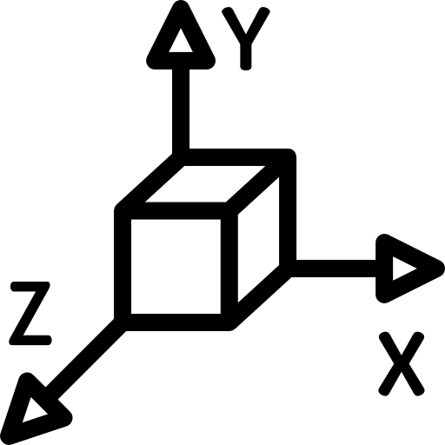

6. Results & Discussion
Bulgogi Burger
Coca Cola
OCR
Image Processing
Relative Coordinate
Accuracy High
Accuracy High
Accuracy High
Important Factor → Performance Determining of the System
But, Sometimes Occur
Notes:
OCR정확도
이미지 처리 정확도
상대좌표 정확도
시스템의 성능 결정

Slide 15
6. Results & Discussion
Goals | Results
Gripper | Because of the limited extent of gripper, we decided to use flipper instead of gripper
Conveyor System | Complete to build up conveyor system with ultrasonic. However, this system is unstable, because various types of shape of each ingredients
OCR | Successful OCR detection system[Publish, Subscribe]
Detect Each Patty | By using the information from each contours, we could detect the types of each ingredients. But, This system also unstable because of the sensitivity from light condition.
Build-up Node / Publish / Subscribe | Successful system between nodes and topics.
Notes:
We set many devices to build up automatic hamburger stacking system. However, according to the various condition of working environment, such as unstable image processing, the hard material of each ingredients, and gripper’s limitation, are results of our system would be changed. Although There are not overall obstruction factors, our system is unstable. To build up stable system for economic benefits, we have to check the overall possibility of developing

